Slide 1
Capstone Project I
Lending Club loan status prediction
Ye Peng Li

Slide 2
Introduction
Lending Club is a US peer-to-peer lending company, operating an online lending platform.
How to find a good borrowers? In other word, how to predict the loan status according to the information of the loan applicants?

Slide 3
Data resource
Lending Club Data Set 2015
Local Area Unemployment Rate in US in 2015

Slide 4
Target variable
The target variable in the project is loan status.
There are 7 types of loan status.
Good loan: 'Current', 'Fully Paid' and 'in grace period’.
Bad loan: 'Charged Off', 'Late (16-30 days)', 'Late (31-120 days)', 'Default’.

Slide 5
Data wrangling
a. Data wrangling of unemployment rate data sets 2015
changing states name to abbreviation
adding missing states unemployment rate
making the counties' name match
b. Data wrangling for lending club data set
Filling blank with 'NaN'
Deleting extra columns
Data format wrangling
Feature engineering

Slide 6
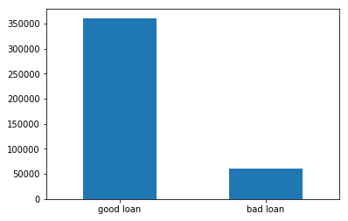
Explanatory Data Analysis
How many good loans and bad loans are there?

Slide 7
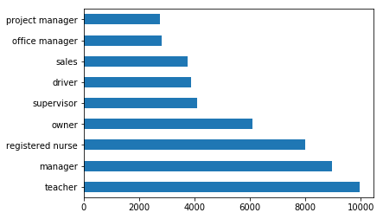
The loan amount and employment title

Slide 8
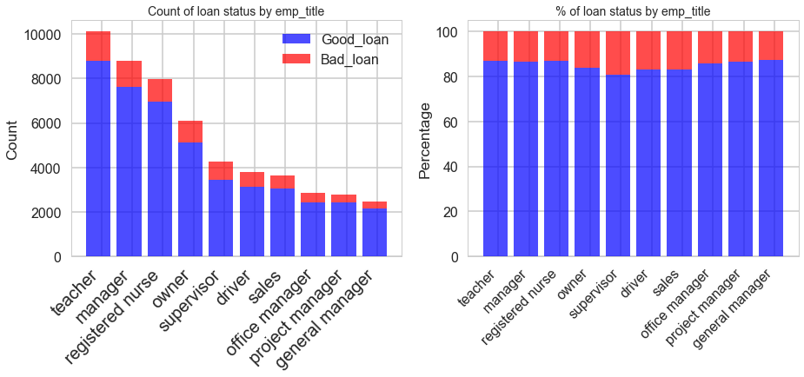
The bad loans for different occupations
Chi square test for the loan status and employment title
chi_squared_stat: 269.3 Critical value: 21.0260698175 P value: 0.0

Slide 9
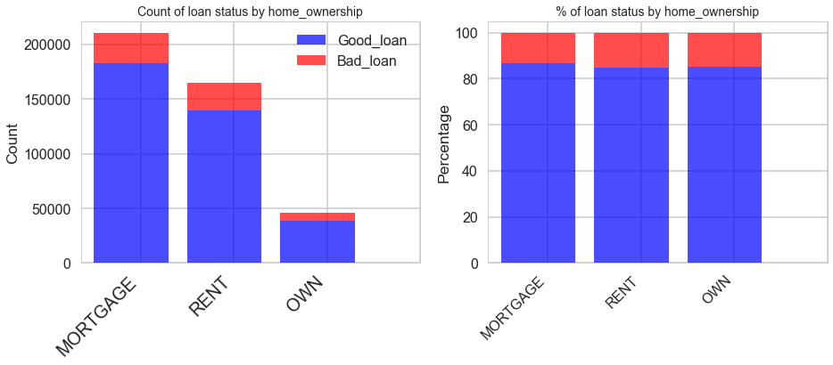
The relationship between loan status and home ownership
Chi square test for loan status and home ownership
chi_squared_stat: 1692.8 Critical value: 11.0704976935 P value: 0.0

Slide 10
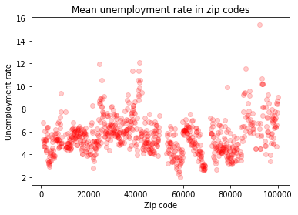
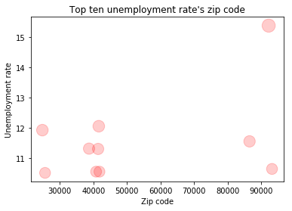
What is the mean unemployment rate in zip codes for bad/good loans?
The top ten unemployment rates locate in three zip codes area(20000, 40000, 90000).States CA and AZ's zip codes are around 90000, KY is around 40000, WV and MS are around 20000.

Slide 11
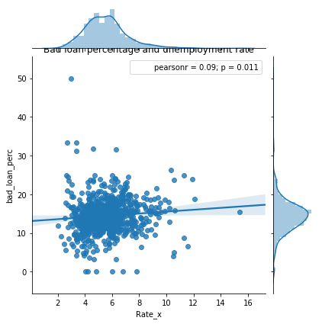
Will the loan lenders in the five states (CA, AZ, KY, WV and MS) which have high unemployment rates also have high bad loan percentage?

Slide 12
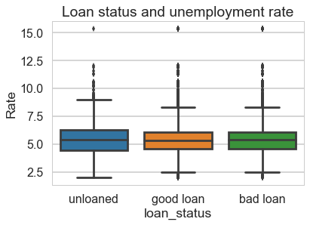
What are the relationships of the mean unemployment rate for people without loan, in good loan status and in bad loan status in the same zip code area?
Unloaded population': 5.523
Good loan lenders: 5.494
Bad loan lenders: 5.555

Slide 13
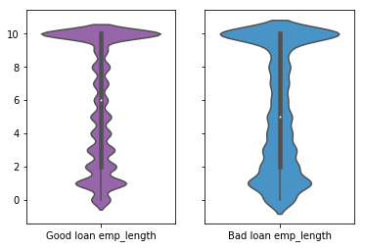
The relationship of employment length and bad loan percentage
Kruskal-Wallis H-test for the median of employment length
Test statistics:
H-statistic: 189435635.4 P-Value: 0.0

Slide 14
Model building
Decision Tree
Easy to Understand
Useful in Data exploration
Less data cleaning required
But it can easily overfit

Slide 15
Hyper parameter tuning for max depth
[(3, 0.85669), (4, 0.85671), (5, 0.85673), (6, 0.85673), (7, 0.85663), (8, 0.85623), (9, 0.85583)]
From the scores we obtained from the tuning process max_depth equaling 5 or 6 is the best choice.

Slide 16
Model score using ‘gini index’ and ‘entropy’
DecisionTreeClassifier(class_weight=None, criterion='gini', max_depth=6, max_features=None, max_leaf_nodes=None, min_impurity_decrease=0.0, min_impurity_split=None, min_samples_leaf=50, min_samples_split=2, min_weight_fraction_leaf=0.0, presort=False, random_state=0, splitter='best')
AUC - ROC gini : 0.636
AUC - ROC entropy : 0.637
The score of the model using 'entropy' is a little bit higher than that using 'gini index'.

Slide 17
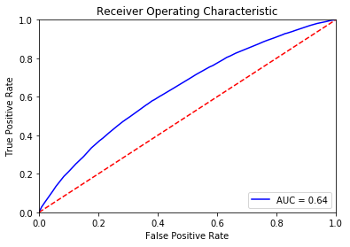
ROC_AUC Curve of Decision tree model
AUC - ROC entropy : 0.637

Slide 18
Model building
Random Forest
An ensemble tool
Taking a subset of observations
Taking a subset of variables to build
Building multiple decision trees

Slide 19
Three features tuned to improve the predictive power of the model:
1. max_features:
2. n_estimators:
3. min_sample_leaf:
Features which will make the model training easier:
1. n_jobs:
2. oob_score:

Slide 20
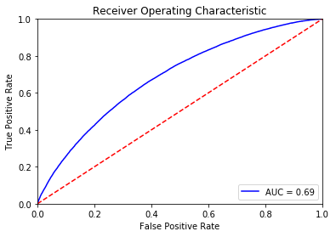
Score the random forest model and plot roc curve
AUC - ROC : 0.685

Slide 21
Model building
Gradient Boosting Method
Producing a prediction model in the form of an ensemble of weak prediction models, typically decision trees.
Building the model in a stage-wise fashion like other boosting methods.
Generalizes models by allowing optimization of an arbitrary differentiable loss function.

Slide 22
Let’s consider the important GBM parameters used to improve model performance in Python:
1. learning_rate
2. n_estimators
3. subsample

Slide 23
Let’s consider the important GBM parameters used to improve model performance
learning_rate
n_estimators
subsample

Slide 24
Tuning the learning rate
learning rate 0.0001 mean scores: 0.8567
learning rate 0.001 mean scores: 0.8567
learning rate 0.005 mean scores: 0.8567
learning rate 0.01 mean scores: 0.85667
learning rate 0.05 mean scores: 0.85688
learning rate 0.1 mean scores: 0.857059

Slide 25
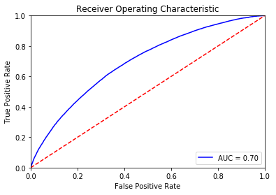
Scoring the GBM model
AUC - ROC : 0.695

Slide 26
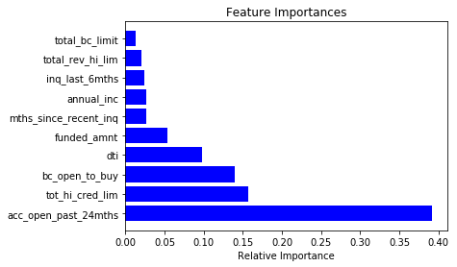
Top 10 important features from Decision tree model

Slide 27
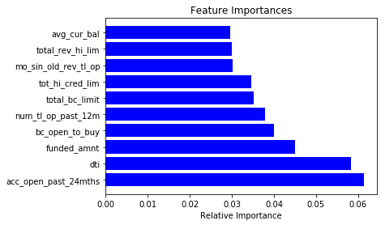
Top 10 important features from Random Forest model

Slide 28
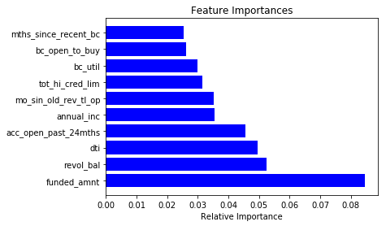
Top 10 important features from Random Forest model

Slide 29
Discussion of three models' top ten important features
Common part:
'acc_open_past_24mths','bc_open_to_buy', 'dti', 'funded_amnt', 'tot_hi_cred_lim'.
Different part:
Order of common important features are different.
Forest and GBM are focus more on bank account information than the Decision tree (0.6 vs 0.4).

Slide 30
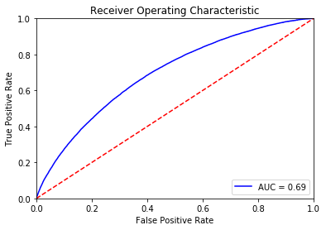
Build a model without 'Rate' variable
AUC - ROC: 0.6949

Slide 31
Random Oversampling in building predictive model
Imbalanced: 80% good loan and 20% bad loan.
Over sampling to balance the data
GBM model
precision_score: 0.704

Slide 32
Summary
To predict the loan status we tried Decision Tree, Random Forest and Gradient Boost method.
ROC_AUC score from 0.637 to 0.695. Gradient Boost method proved to be the best method for the predictive model.

